Slide 1
Adolescent Substance Use Treatment Screening and Treatment Capacity Expansion
University of Texas HSC at San Antonio
University of Texas HSC at Houston
Texas Tech University HSC at Lubbock
University of Texas HSC at Tyler
University of Texas at Austin, Dell School of Medicine

Slide 2
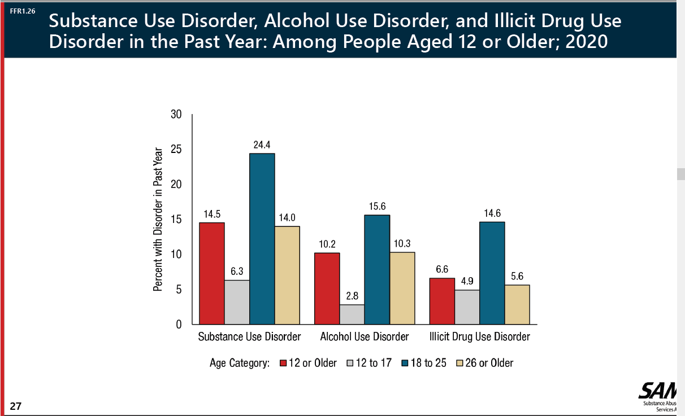
Youth SUD: Prevalent, Pernicious & Persistent

Slide 3
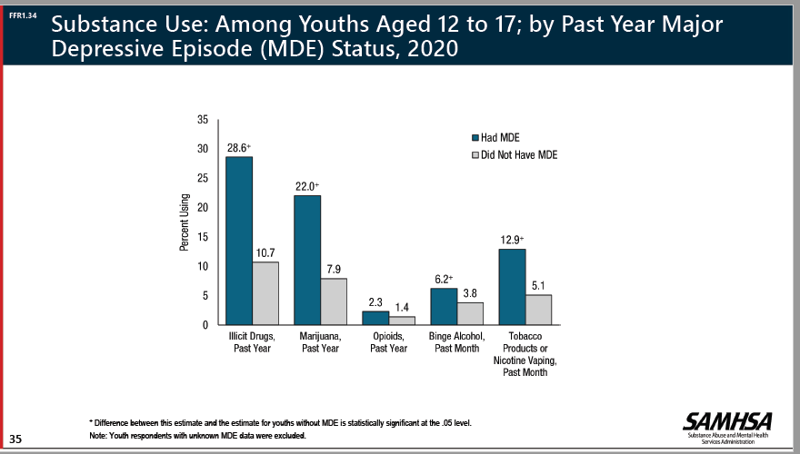
Strong relationship to MH disorders

Slide 4
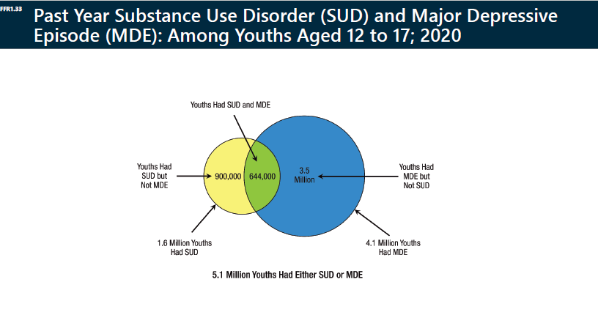
Strong relationship to MH disorders

Slide 5
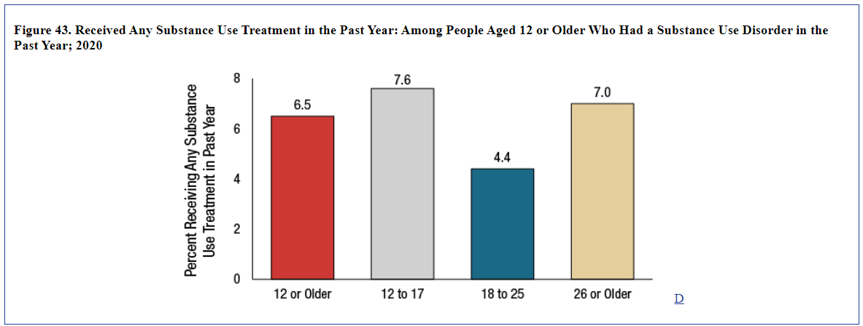
Only a fraction of those with SUD get treatment (at all ages)

Slide 6
Aims
Implement systematic screening and matching need to intervention.
Screening, Brief Intervention, and Treatment Model (SBIRT)
Initial focus on TCHATT.
Cultivate and deploy evidence-based interventions to A-SUD
Brief Intervention, Motivational Enhancement
Family-based contingency mgt; CBT; pharmacotherapy as appropriate
Relapse prevention and monitoring
Community outreach for education and training
Diverse target audience

Slide 7
Referral Pathways - tentative
TCHATT and schools
Other community health providers
Family or youth self-referrals
Target Patient Group for SUD Specialty Treatment
  Youth 13 to 18
  Use of ETOH/substances screens in the “Treatment” range
    or
  Very high-risk use (based on substance, settings for use, other factors)

Slide 8
Specialty Competencies to Develop or Refine
Cognitive-Behavioral
Motivational Enhancement / Motivational Interviewing
Drug/ETOH refusal skills
Target factors that precipitate substance involvement
Establishing alternate leisure activities and peers
Validated psychotherapies for mood and anxiety disturbances.
Family-Based
Contingency management (adolescent version)
Improved monitoring and supervision; cohesion and conflict reduction.
Facilitating alternate leisure activities and peers.
Risk reduction, restricting access
Facilitate substance-related tx for other family members, as indicated.
Other or Under Consideration by Site
Pharmacotherapy. U/A, PEtH, etc. Peer guidance. MAT.

Slide 9
Linkages to Related Programs & Organizations
Including…
  HHSC
  Association of Substance Abuse Providers
  Be Well Texas
  Juvenile/Family Court

Slide 10
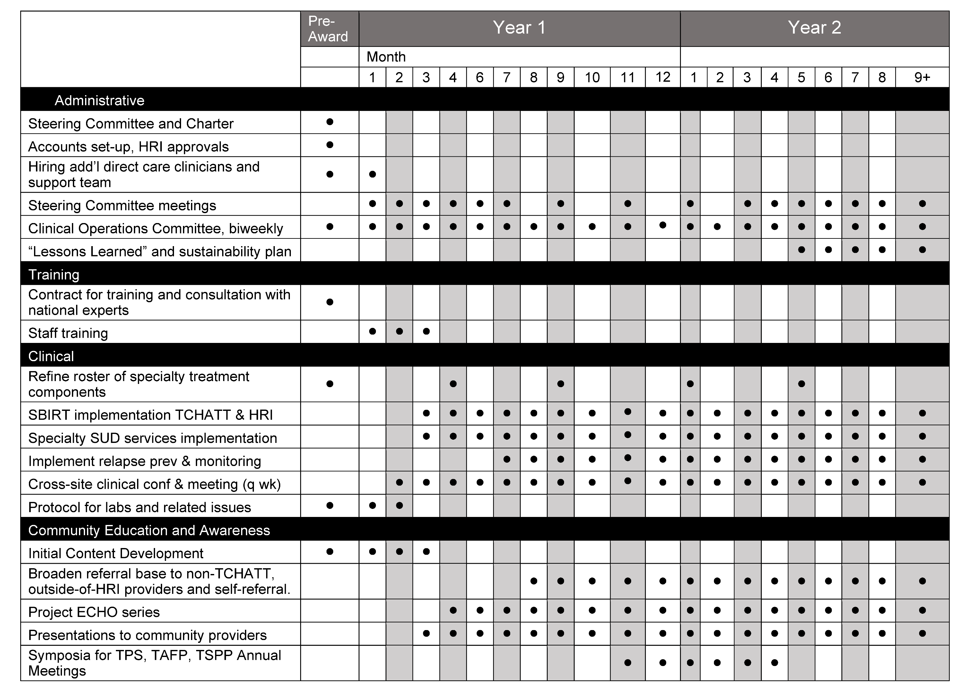
Timeline Draft

