Slide 1
TCMHCC External Evaluation Year 1 Findings
Lara Savas, PhD and Melissa Peskin, PhD
UTHealth School of Public Health

Slide 2
Year 1 Evaluation of CPAN and TCHATT
Formative evaluation
  Qualitative assessment and workflow process mapping
Ongoing process and outcome evaluation:
  Examination of reach and services delivered (Trayt data)
  Assessment of contextual factors influencing CPAN and TCHATT engagement and implementation (External Evaluation surveys)
Notes:
Formative (qualitative assessment and workflow process mapping) evaluation through key-informant interviews to establish a baseline of current practice for each HRI, as well as for a sample of clinics and districts/schools engaged in CPAN and TCHATT

Slide 3
1.
CPAN & TCHATT
Process Mapping
Qualitative Interviews

Slide 4
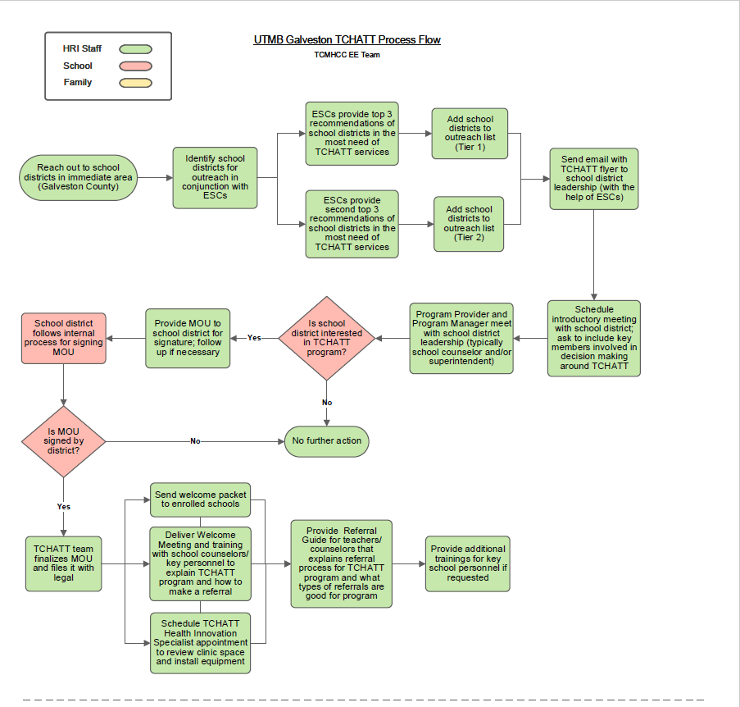
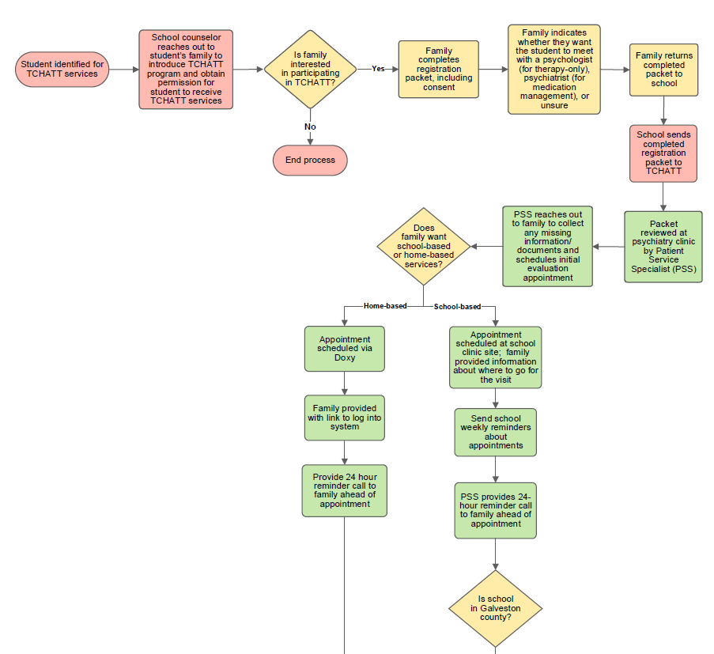
Formative Evaluation
Completed 48 process maps
  12 CPAN and 12 TCHATT HRIs
  Sample of 12 CPAN clinics
  Sample of 12 TCHATT school districts
Identify activities and practices that were common across HRIs, clinics & school districts
Process mapping and qualitative findings indicate variation in implementation processes, outreach and engagement strategies, and resources used across sites
Notes:
HRIs: flow of activities from beginning to end (outreach, enrolling clinics, engagement, service delivery)
Activities also used for cost evaluation

Slide 5
Formative Evaluation: Key Findings from CPAN Clinic Process Mapping Interviews
Variation in training across HRIs
  All (n=12) interviewed clinics reported receiving brochures or other information about CPAN during the enrollment process
  Five of 12 clinics recalled receiving any training from the HRI
  Among the clinics that reported they did not receive training, several (n=4) indicated that a training would have been helpful
Desire for more education about mental health topics
  About half (n=7) of clinics reported receiving information from the HRI through email or monthly newsletters.
  Among clinics not receiving information, a few (n=3) mentioned that they would like to receive ongoing communication and education about mental health topics from the HRI.
  Clinics indicated specific resources that would be helpful, including a list of types of therapies and community resources.

Slide 6
Formative Evaluation: Key Findings from TCHATT District Process Mapping Interviews
Variation in follow-up communication from the HRI
  Several counselors (n=7) were very pleased with the level of communication they have had with the HRI
  Some counselors (n=3) indicated that there is not much communication from the HRI after submitting referrals and they would appreciate receiving status on students going through TCHATT sessions from HRIs
Barriers to TCHATT
  A few school districts (n=5) mentioned that obtaining parental consent was their biggest barrier.
  Space was an issue for some school districts (n=3), since they only had one private room for TCHATT sessions.
  Two districts mentioned that they had challenges utilizing TCHATT for younger children since telehealth appointments are not as engaging for them.
Notes:
There was variation in follow-up communication that school counselors reported from the HRI.
Several counselors (n=7) were very pleased with the level of communication they have had with the HRI. Counselors mentioned receiving brief updates between sessions and, in some cases, a final report with HRI recommendations for ongoing care. One counselor said that she has the opportunity to request a consult between herself and the provider before the student meets with the provider and that she sometimes attends follow-up sessions as well.
Conversely, some (n=3) counselors mentioned that there is not much communication from the HRI after submitting referrals. They indicated that they would appreciate receiving status updates from HRIs on students going through TCHATT sessions.
An emphasis on communication between the HRI and school district came up in most interviews (n=10), but it was especially apparent for the smaller school districts.
Several barriers were brought up during the interviews.
A few school districts (n=5) mentioned that obtaining parental consent was their biggest barrier. Two of those districts felt that they could get better buy-in from parents if more TCHATT sessions were offered.
Space was an issue for some school districts (n=3), since they only had one private room for TCHATT sessions.
Two others mentioned that they had challenges utilizing TCHATT for younger children since telehealth appointments are not as engaging for them.

Slide 7
Summary of Key Findings
Process Mapping:
  Process mapping and qualitative findings indicate variation in implementation processes, outreach and engagement strategies, and resources used across sites.
  Process Maps serve as a baseline of strategies used across HRIs. Strategies will be monitored to identify successful approaches related to implementation and outcomes.
  Several HRI leads expressed interest in learning more about processes used by other HRIs, providing insight into the usefulness of the maps as a learning tool that will help facilitate sharing of unique strategies and leveraging best practices.

Slide 8
2b.
Process and
Outcome Evaluation
External Evaluation CPAN & TCHATT Surveys

Slide 9
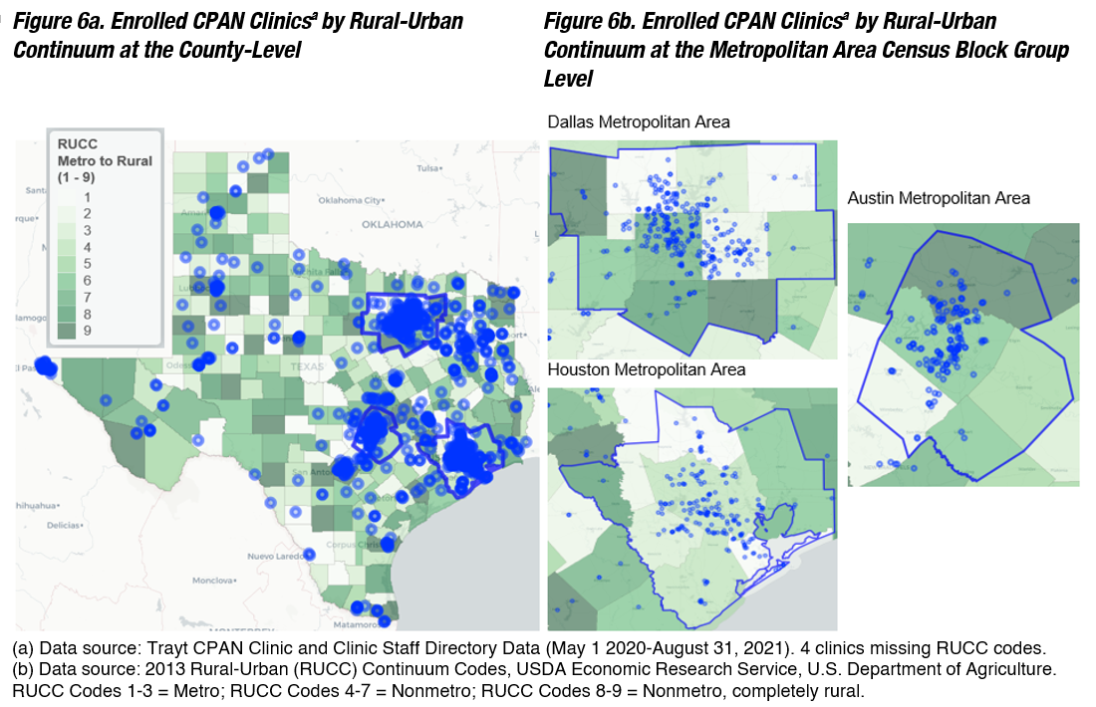
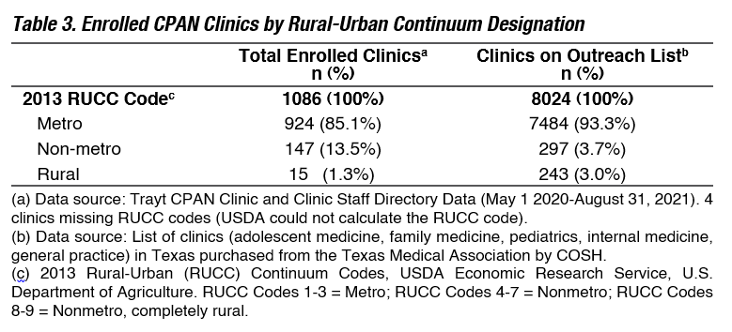
CPAN Network Development: Clinic and Provider Reach
(Trayt Data: May 2020-August 2021)
13.5% of enrolled clinics located in non-metropolitan counties
1.3% of enrolled clinics located in rural counties
Notes:
The geographic distribution of clinics enrolled, characterized by the rural to urban continuum, reflects an overrepresentation of clinics located in non-metropolitan counties (13.5% of CPAN enrolled clinics) compared with Texas clinics that serve Texas youth overall (3.7%), and 1.3% of CPAN enrolled clinics are located in rural counties compared with Texas clinics that serve youth overall (3.0%) (Table 3). Within the major metropolitan areas, the geographic spread of community clinics enrolled reflect widespread coverage across community settings (Figures 6a-b).

Slide 10
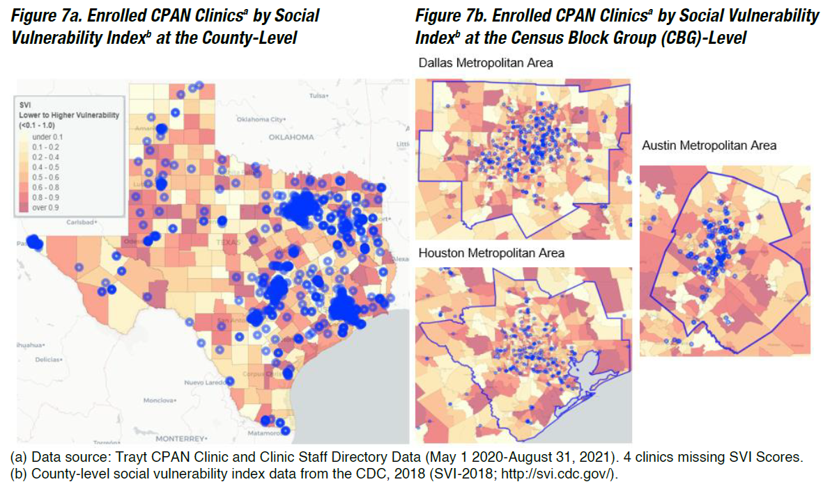
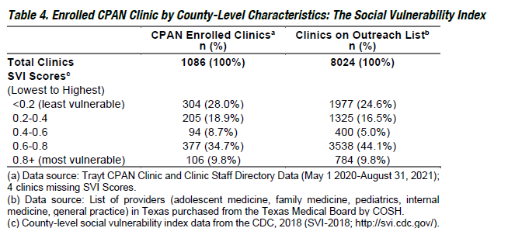
CPAN Network Development: Clinic and Provider Reach
(Trayt Data: May 2020-August 2021)
44.5% of enrolled clinics located in the highest two quintiles of vulnerable counties (SVI score > 0.6)
Notes:
Almost half (44.5%) of enrolled clinics are located in areas in the highest two quintiles of vulnerable counties (CDC Social Vulnerability Index [SVI] score over 0.6) compared with 53.9% of all clinics targeted for enrollment¹ (Table 4).

Slide 11
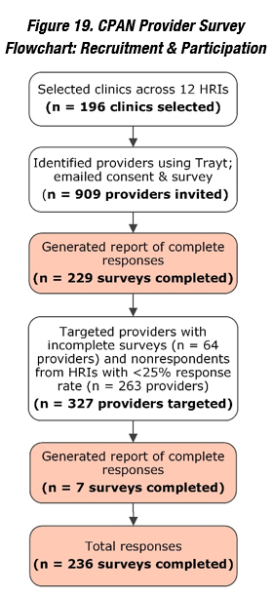
Year 1 CPAN Survey
Surveyed diverse sample of 236 providers across 86 clinics or clinic systems
Examined factors associated with implementation, engagement with the program, and perceived need for the program
Worked with Consortium directors of enrolled clinics and providers to ensure the creation of a diverse sample of clinics with respect to SES, clinic size, and geographic region
Collected quantitative and qualitative data
Notes:
We surveyed a diverse sample of 236 providers across 86 clinics or clinics systems to examine factors influencing implementation of CPAN at the clinic-level and engagement with the program at the provider-level, such as fidelity, satisfaction, and contextual factors, such as organizational factors (e.g., leadership and capacity), and perceived need for the program.
Similar to our process mapping approach, we worked with the Consortium directors of enrolled clinics and providers to ensure that we surveyed informants from a diverse sample of clinics with respect to socio-economic status (e.g., designation or non-designation of federally qualified health center), clinic size, and geographic region.
Ideally, we would have the parent perspective as part of this evaluation

Slide 12
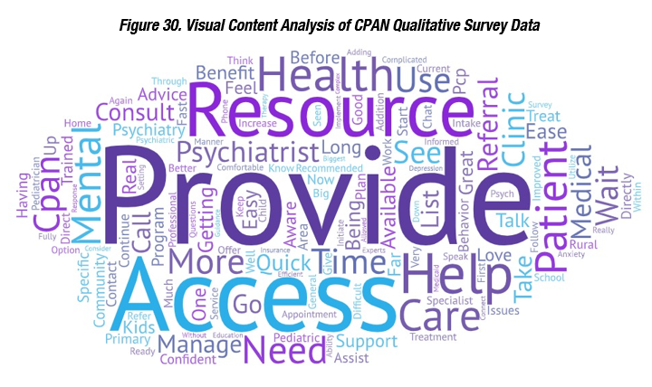
Summary of CPAN Survey Key Findings
Clinics or clinic systems who reported at least one call reported more favorable CPAN motivation (including relative advantage, observability priority, lower complexity) compared to clinics or clinic systems who reported no calls
More than 70% of providers reported their knowledge, skills, and confidence to provide mental health care increased moderately or very much due to CPAN
Over 90% of providers reported they would recommend CPAN to other providers and use CPAN in the next 6 months
Most frequently mentioned areas of improvement include desire for expanded services, improved outreach and awareness of CPAN in the community, additional communication options, more training, and improved connections to resources and referrals in the community
Notes:
Surveyed clinics or clinic systems mirror the distribution of clinics or clinic systems enrolled in TRAYT (as of 7/8/21) in terms of geographic and population-level vulnerability indicators. However, non-metro (urban) TRAYT enrolled and surveyed clinics or clinic systems are over-represented when compared to the total outreach population, and metro and non-metro (rural) TRAYT enrolled and surveyed clinics or clinic systems are under-represented when compared to the total outreach population. Social vulnerability index scores were similar across the three groups (Table 29).

Slide 13
Provider-Level Qualitative Results
“CPAN has allowed me to consult with a psychiatrist about more complex mental health patients… It has given me the confidence to start medications I otherwise would not have.”
“Taking this survey, I now realize that CPAN provides many resources other than just consult with psychiatrist. I have taken some of the CME, but it would be helpful to be aware of some of the other resources they provide.”
“Sometimes the referral list we get is not up to date - providers no longer accepting patients or insurance - this is tough, but really important to keep as current as possible.”

Slide 14
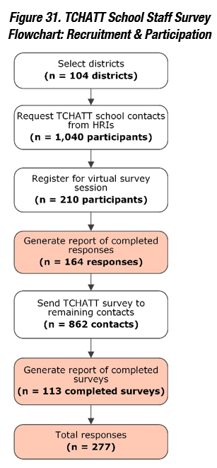
Year 1 TCHATT Survey
Surveyed diverse 277 school staff across 172 school campuses
Examined factors associated with implementation, engagement with the program, and perceived need for the program
Worked to ensure the creation of a diverse sample of school campuses with respect to SES, school campus size, and geographic region
Collected quantitative and qualitative data
Notes:
We surveyed 277 school staff across 172 school campuses to examine factors influencing implementation of TCHATT at the school campus and engagement with the program at the provider-level, such as fidelity, satisfaction, and contextual factors, such as organizational factors (e.g., leadership and capacity), and perceived need for the program.
We worked to ensure that we surveyed informants from a diverse sample of school campuses with respect to socio-economic status (e.g., % of students who received free or reduced lunch), school campus size, and geographic region.

Slide 15
Summary of TCHATT Key Findings
Vast majority of campuses (almost 95%) reported implementing TCHATT at some level
Approximately 60% of surveyed implementing TCHATT campuses reported that 1 in 4 students in their campus population had need of non-educational supports such as meals, clothing, and/or counseling or behavioral therapy
Almost 70% reported that TCHATT increased school capacity to meet non-educational needs of students
Approximately 90% reported that they would recommend TCHATT to other schools and to use TCHATT in the next 6 months
Areas of improvement included the desire for better communication and follow-up, a more efficient system for paperwork, additional student sessions, more training on campus, marketing tools and informational material for parents, and implementation expansion to other campuses d TCHATT to other schools and to use TCHATT in the next 6 months
Notes:
Enrolled campuses in TRAYT as of 6/8/21 over-represent metro campuses; surveyed campuses, however, mirror the percentage of TEA metro campuses.
Surveyed campuses over-represent non-metro campuses when compared to the percentage of non-metro campuses enrolled in TRAYT as of 6/8/21.
Rural campuses are under-represented among enrolled and surveyed campuses (Table 43).
When compared to all Texas campuses, there is an over-representation of campuses with 500-1000 and 1000-1500 student in the enrolled and surveyed groups and an under-representation of campuses with less than 500 students (Table 43).

Slide 16
School Staff-Level Qualitative Results
“I would like to be communicated with about my students after every session to be aware of how I can support my students in the school setting…This was initially part of the TCHATT program, but then went away.”
“I wish we had more informational papers to hand out (brochures, explanations) to our parents. I think we would have more participation if the information was widely available.”
“TCHATT has been a blessing to our less fortunate families who are in need of mental health services. Being able to provide this service to our students has contributed tremendously with regards to better attendance, grades and discipline.”

